Slide 1
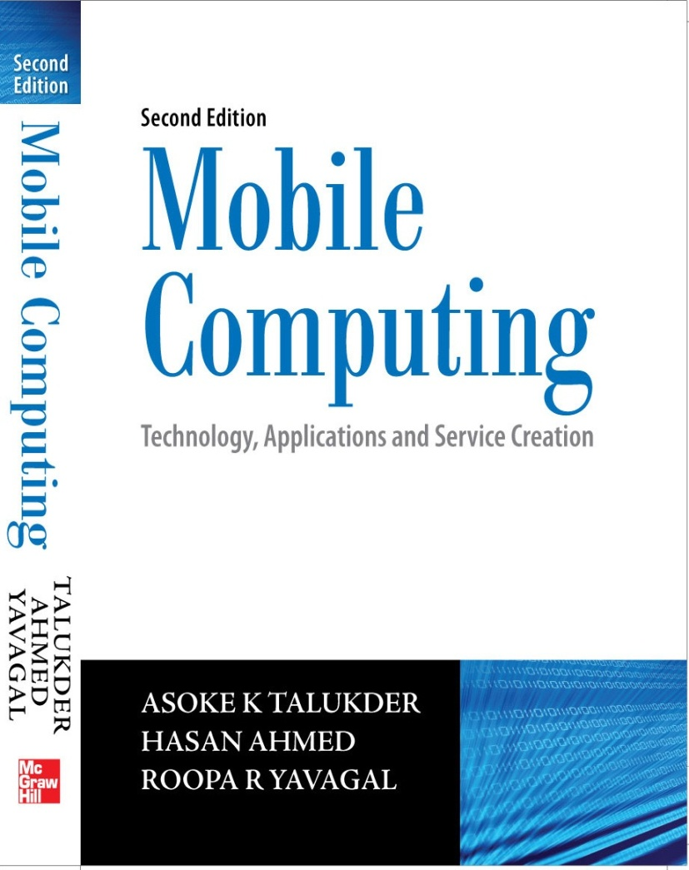
Notes#11
Security Issues in Mobile Computing

Slide 2
Introduction
Networked information systems increase the risks for sensitive information supporting critical functions in the organization which are open to attacks
Wireless media works on the principle of broadcast where information is radiated to everyone within the radio wave range, thus, increasing the security threats
Cyber attacks can be replicated quite easily

Slide 3
Information Security
Who is the enemy?
What are the vulnerabilities? What are the weak links in the system?
What could be the possible exploitation of these vulnerabilities by the resulting attacks?
What needs special protection?

Slide 4
Information Security
How much does the security system cost in terms of money, resource and time?
To what extent, the deployed security system will affect the openness and add to inconvenience?
Is prevention better that cure? If prevention is expensive or impractical, what is the strategy to recover from the loss following an attack?

Slide 5
Attacks
Where the vulnerability is exploited, there is a loss
Loss can be either of static information asset (static asset) or an information asset in transit (dynamic asset)
If we look at an information system, static assets cover a large portion of the asset base
All the databases, files, documents, etc. in the computers/networks fall in this category
Examples of attacks on static asset are virus deleting files in a computer or jamming a network
An example of an attack on a dynamic asset is the theft of a credit card number while a user is doing a credit card transaction on the web

Slide 6
Attacks on Static Assets
Virus and Worms: These are a type of program that replicates and propagates from one system to another doing malicious functions in the system.
Denial of Service: These are attacks on the system to prevent legitimate users from using the service.
Intrusion Attacks: These are people or software which enter into computer systems and perform function without the knowledge of the owner of the asset.
Replay Attacks: In a replay attack, the opponent passively captures the data without trying to analyze the content. At a later time, the same is used in the same sequence to impersonate an event and gain unauthorized access to resource.

Slide 7
Attacks on Static Assets
Buffer Overflow Attacks: In a buffer overflow attack, the vulnerability of an executable program is exploited to force a stack overflow condition inducing the program counter of the process to change. The program counter is then manipulated to do the work for the attacker.
Trapdoor Attacks: These are exploitations of some undocumented features of a system. Undocumented functionality are designed to debug, service, support or take control of the system.

Slide 8
Attacks on Dynamic Assets
Interception: An unauthorized party gaining access to an asset will be part of this attack. This is an attack on confidentiality like unauthorized copying of files or tapping a conversation between parties. Some of the sniffing attacks fall in this category.
Modification: An unauthorized party gaining control of an asset and tampering with it is part of this attack. This is an attack on integrity like changing the content of a message being transmitted through the network. Different types of man-in-the-middle attacks are part of this type of attack.

Slide 9
Attacks on Dynamic Assets
Fabrication: An unauthorized party inserts counterfeited objects into the system. For example, impersonating someone and inserting a spurious message in a network.
Interruption: An asset is destroyed or made unusable. This is an attack on availability. This attack can be on a static asset or a dynamic asset. An example could be cutting a communication line or making the router so busy that a user cannot use a server in a network. These are all denial of service attacks.

Slide 10
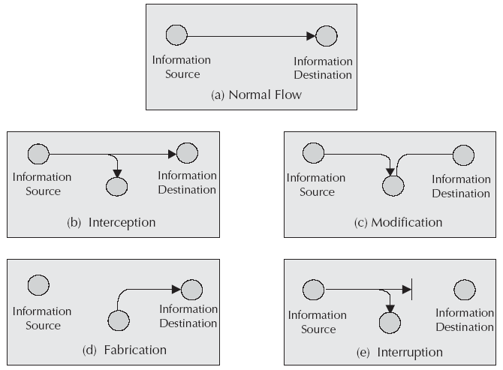
Attacks on Dynamic Assets

Slide 11
Components of Information Security
Confidentiality
Integrity
Availability
Non-repudiation
Authorization
Trust
Accounting

Slide 12
Confidentiality
Confidentiality is the property where the information is kept secret so that unauthorized persons cannot get the information.
Cryptography helps achieve confidentiality.
Cryptography is a process of making a message un-intelligible to un-intended users.

Slide 13
Cryptography
Through encryption (or encipher), we disguise plaintext message in such a fashion that it is no longer understandable by either a person or a machine.
Plaintext need not be a written text as it can even be an audio or video message as well.
An encrypted message is called ciphertext.
The process of converting a ciphertext back into plaintext is called decryption (or deciphering).
In cryptography, there are two components - algorithms and protocols.

Slide 14
Cryptography
A cryptographic algorithm is a mathematical function used for encryption and decryption while protocol relates to the process and procedure of using algorithms.
A protocol is the way algorithms are used to ensure that the security is ensured and the system is less prone to attack.
In a security system, the plaintext message is encrypted by using a key KEY(E).
The encrypted message is then sent from the sender to the received through a media (wired, wireless or even postal) using some protocol. The encrypted message is then decrypted using a key KEY(D) to extract the original message.

Slide 15
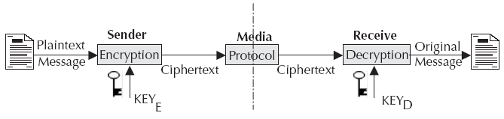
Cryptography

Slide 16
Cryptography
A cryptographic key is generally a large number. The range of possible values of a key is called keyspace.
The larger the keyspace is, the more difficult it is for an attacker to guess the key and restore the original message.
People who practice cryptography are called cryptographers.
People who try to break the secrecy of the cryptography are called cryptanalysts and the practice of cryptanalyst is called cryptanalysis.
Steganography is the science of hiding secret message in other messages so that the existence of the secret message is concealed. For example, sending some secret message by changing some bits in a large picture message.

Slide 17
Integrity
Integrity is to ensure the integrity of the message.
Integrity is achieved by adding additional information in to the message through checksums, message digests, digital signatures.
In a crypto system, the receiver of the message checks the extra information to verify whether the message has been tampered with.
Integrity check is advised for both static asset and asset on transit.

Slide 18
Authorization
Authorization deals with privileges.
The privilege to an object is defined through ACL or Access Control List. ACL is used while allowing access to the object. The privilege on an object can be read, write or execute.
Authorization is implemented through policy based resource accessibility.
Privilege management infrastructure together with the role based authorization allows the administration and enforcement of user privileges and transaction entitlements.
In the authorization process, users are checked to see if they have the required rights to access the resource.

Slide 19
Non-repudiation
In non-repudiation, the identity of transacting parties are confirmed beyond any point of doubt.
Non-repudiation can be considered as authentication with formal record which shall have legal bindings.
Like a signature in a cheque, digital signatures can be used to achieve non-repudiation.

Slide 20
Availability
Availability is the property of a system by which the system is be available to its legitimate users.
If an attacker manipulates the media to make sure that the message does not reach the destination, then he has attacked availability.
Attack on availability happens for industrial espionage or from political motivation.
This field of research area is called Censorship-resistant publishing.
Censorship-resistant publishing is achieved through document entanglement.

Slide 21
Trust
Trust is the property of expectation, confidence and belief over time.
Trust involves developing a security policy, assigning credentials to entities and verifying that the credentials fulfill the policy.

Slide 22
Accounting
Accounting is the property of calculating the fee for a service rendered.
Accounting is the process by which the usage of the service is metered.
Based upon the usage, the service provider collects the fee either directly from the customer or through the home network.
This is true even if the user is roaming in a foreign network and using the services in the foreign network.
Remote Authentication Dial In User Service (RADIUS) has been in use for a long time for the Authentication, Authorization and Accounting (AAA) functions in Internet.

Slide 23
Stream and Block Ciphering
In stream ciphering, a bit or a byte is taken at a time and encrypted. The algorithm looks at the input plaintext as a stream of bits and encrypts them one bit (or byte) at a time as the stream progresses. Here, the length of the plaintext and the key size will be same.
In block ciphering, one block of plaintext is taken as a whole and used to produce a cipher text block of equal length. Typically, a block of 64 bits (8 octets) or 128 bits (16 octets) is used for block cipher. Majority of cryptosystems use block cipher.

Slide 24
Symmetric Key Cryptography
Same key is used for both encryption and decryption and the process is like a lock where the same key is used to lock and unlock.
Symmetric key algorithms are called conventional or classical algorithms.
The unique key chosen for use in a particular transaction makes the results of encryption unique. Selection of a different key causes the cipher that is produced for any given set of inputs to be different.
The cryptographic security of the data depends on the security of the algorithm used and the key used to encipher the data. The strength of the security depends on the size of the key.

Slide 25
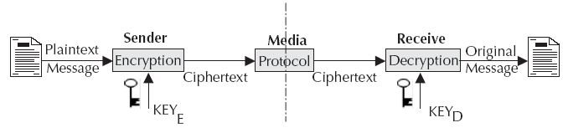
Symmetric Key Cryptography
In a symmetric key cryptography, there are four components: plaintext, encryption/decryption algorithm, secret key (key for encryption and decryption) and the ciphertext.
In the figure below, if we make KeyE = KeyD, it becomes a symmetric key algorithm.

Slide 26
Symmetric Key Algorithms
DES: Data Encryption Standard algorithm is the most widely used, researched and has had the longest life so far.
3DES: This is a modification of DES where DES is used three times in succession.
AES: Advances Encryption Standards is the current accepted standard for encryption by Federal Information Processing Standards (FIPS) of USA.
Skipjack/FORTEZZA: This is a token based symmetric algorithm used by defense personnel in the US.

Slide 27
Data Encryption Standard
DES employs the principle of scrambling and substitution. These processes are repeated a number of times with keys to ensure that the plaintext is completely transformed into a thoroughly scrambled bit stream. There are five major functions:
Permutations of bits in a block. This is the first and last step in DES. In this step the 64-bit plaintext block is rearranged through Initial Permutation IP. This is done through a 64-bit register where the bits of the input block are scrambled in a particular fashion.
A key dependent computation. This includes multiple rounds (iteration) of transformation through combination of permutation and substitution. This is in the core of the encryption function.

Slide 28
Data Encryption Standard
Swapping of half blocks of data in each round.
Key schedule which breaks the 56-bit key into two 28-bit subkeys and use them to compute the bits in data blocks. In each iteration, the bits within the subkey are shifted to generate a new subkey.
The key dependent computation is run through 16 rounds where each round uses the data from the previous round as input.
The beauty of DES algorithm is that the same algorithm is used for both encryption and decryption.
DES demonstrates a very high avalanche effect. In an avalanche effect, one bit of change in either the input data or the key changes many bits in the output.

Slide 29
Advanced Encryption Standard
National Institute of Standards and Technology (NIST) of US issued a call for algorithms for AES where AES was to have equal or better security compared to 3DES and more efficient than the 3DES.
Rijndael was selected as the AES algorithm and had the following characteristics:
Resistance against all known attacks
Design simplicity
Speed and code compactness on a wide range of platforms

Slide 30
Public Key Cryptography
Public key cryptosystem is based on mathematical functions rather than permutation and substitution.
It is computationally infeasible to derive the decryption key given only the encryption key and knowledge of the cryptographic algorithm.
The encryption key and the decryption key together form a key pair. One of these keys from the key pair is made public and the other one is kept private or secret. That is why this algorithm is called public key cryptosystem.

Slide 31
Public Key Cryptography Terms
Plaintext: This is the human readable message or data given to the public key algorithm as input for encryption.
Ciphertext: This is the scrambled data produced as output of the encryption algorithm. This is a unique data and depends only on the unique key used for encryption.
Encryption algorithm: This is the algorithm that does computation and various transformations on the input plaintext. The output of the transformation is too garbled to be decipherable for an intruder.
Decryption algorithm: This algorithm does the reverse function of the encryption algorithm. This function accepts the ciphertext as input and does some transformation on the data so that the original data is recovered.

Slide 32
Public Key Cryptography Terms
Public key: This is one of the keys from the key pair. This key is made public for anybody to access. This key can be used either for encryption or decryption.
Private key: This is the other key from the key pair. This key is called the private key, because this is kept secret. This can be used either for encryption or decryption.

Slide 33
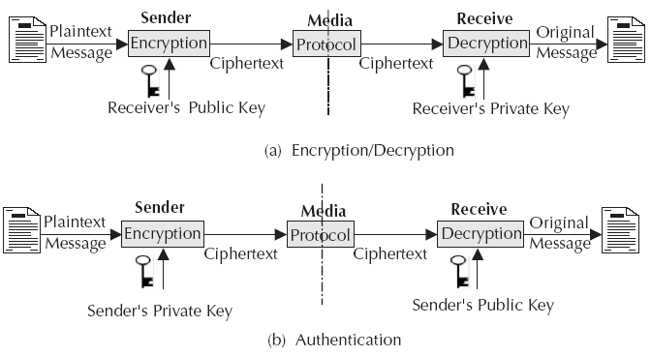
Public Key Cryptography Mechanism

Slide 34
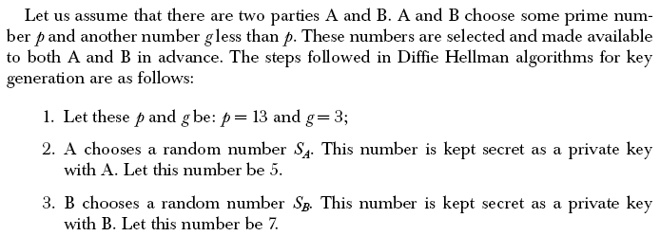
Diffie Helman Algorithm
In Diffie Hellman technique, secret keys are never exchanged. However, the technique allows two parties to arrive at a secret key through the usage of public keys.
Communicating parties select a pair of private and public keys. Public keys are exchanged. The shared secret key is generated from the private key and the public key of the other party.

Slide 35
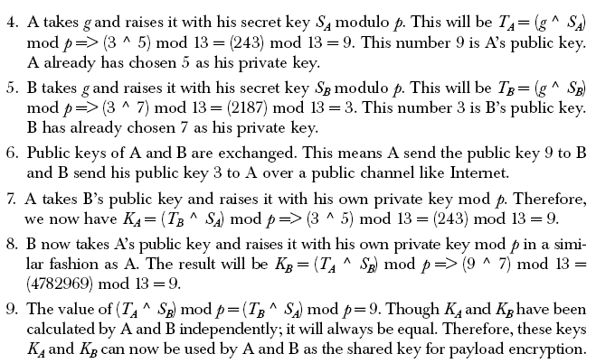
Diffie Helman Algorithm

Slide 36
RSA Algorithm
RSA is named after its inventors R.L. Rivest, A. Shamir and L. Adleman. It is a public key algorithm that does encryption/decryption, authentication and digital signature.
Key length can be large for higher security and it can be smaller for better efficiency.
The plaintext data block is always smaller than the key length. However, the ciphertext block is the same as the key length.
RSA is much slower than symmetric key encryption. That is why RSA is generally not used for payload encryption. RSA is used primarily for encrypting a secret key for key exchange.

Slide 37
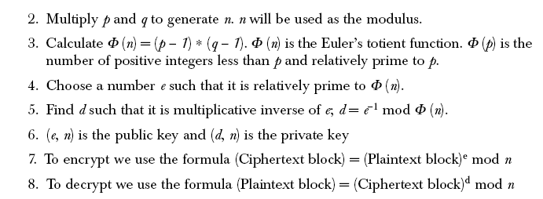
RSA Algorithm

Slide 38
ECC
Elliptic Carve Cryptography (ECC) has shown a lot of promise for higher security with lesser resource.
An elliptic curve is the set of solutions (x,y) to an equation of the form y² = x³ + ax + b, together with an extra point O which is called the point at infinity.
ECC is believed to offer a similar level of security with a much smaller size of key. For example, it is claimed that the level of security that 1024 bits of RSA provide can be achieved by 160 bits of ECC. A 210-bit key of ECC is equivalent to 2048 bits of RSA.
This makes ECC very attractive for small footprint devices like cell phones or PDAs.

Slide 39
Hashing Algorithms
Hashing functions are one way functions used for message digests.
Hash function takes an input data of any size and produces an output stream of some fixed size. The outputs are collision free. This means that two different inputs will not produce the same output.
It is also not possible to derive the input from a known output. This means that if we have a message digest, it is impossible to derive the original message.
The most commonly used hash functions are MD5 and SHA-1.

Slide 40
MD 5 Algorithm
Message Digest version 5 (MD 5) hashing algorithm takes a message of arbitrary length as input and produces a 128 bit message digest as output.
The algorithm processes 512 bits of the input message in blocks. The digest produced by the algorithm can also be considered as a fingerprint of the message.
It is conjectured that it is computationally infeasible to produce two messages having the same message digest. It is also conjectured that it is computationally infeasible to produce any message having a given message digest.
The MD5 algorithm is intended for digital signature applications in a public key cryptosystem.

Slide 41
SHA Algorithm
SHA processes input in 512 bits block and produces 160 bits of output.
Like MD5, SHA-1 is also based on MD4 algorithm.
As both MD5 and SHA-1 are based on MD4, they are quite similar in nature.
However, as SHA-1 generates a longer digest of 160 bits compared to 128 bits by MD5, it is considered to be more secure.

Slide 42
MAC Algorithm
MAC stands for Message Authentication Code and is used to do the integrity check on the message.
A secret key is used to generate a small fixed size data block from the message. Both the sender and the receiver share the same secret key for MAC. When the sender has a message to be sent to the receiver, the message is sent along with the MAC. The receiver receives the message and calculates the MAC from the message and the shared key. The receiver checks the MAC received from the sender.
If they are the same, the message is considered to be in perfect state.
HMAC is another mechanism for message authentication using cryptographic hash functions like MD5, SHA-1, etc.

Slide 43
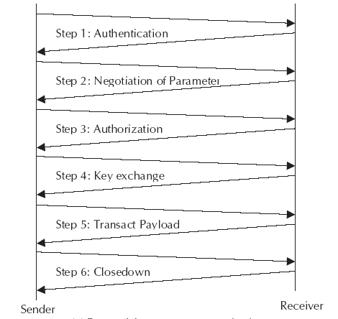
Protocol for Secure Communication

Slide 44
SSL
Secured Socket Layer (SSL) protocol is used to provide security of data over public networks like Internet.
It runs above the TCP/IP protocol layer and below higher level protocols such as HTTP or IMAP.
SSL allows both machines (server and client) to establish a secured encrypted channel so that all the data transacted between them are confidential and tamper resistant.
SSL protocol uses a combination of both public key and symmetric key encryption.
An SSL session begins with SSL handshake. SSL handshake allows the server to authenticate itself to the client using public-key techniques.

Slide 45
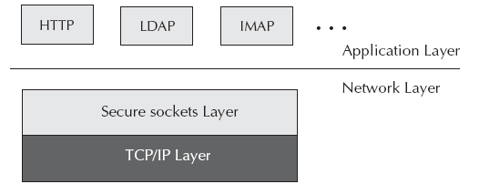
SSL Layer

Slide 46
TLS
Transport Layer Security (TLS) is a security protocol to offer secured communication at the transport layer.
The primary goal of the TLS protocol is to provide privacy and data integrity between two communicating applications.
At the lower levels, TLS uses TCP transport protocol.
TLS protocol is composed of two layers: the TLS Handshake Protocol and the TLS Record Protocol.

Slide 47
TLS Handshake Protocol
TLS Handshake Protocol provides connection security that has three basic properties:
Peer’s identity can be authenticated using asymmetric or public key cryptography.
The negotiation is reliable: no attacker can modify the negotiation communication without being detected by the parties in the communication.
The negotiation of a shared secret is secured: the negotiated secret is unavailable to anybody eavesdropping in the middle of the connection.

Slide 48
TLS Record Protocol
TLS Record Protocol provides connection security that has two basic properties:
Privacy: The confidentiality of the data is maintained through encryption. Symmetric cryptography is used for data encryption. Keys for symmetric encryption are generated uniquely for each connection. These encryption algorithms are negotiated by the TLS Handshake Protocol.
Integrity: The connection is reliable. Message transport includes a message integrity check using a keyed MAC. Secure hash functions are used for MAC computations.

Slide 49
WTLS
Transport layer security protocol in the WAP architecture is called the Wireless Transport Layer Security (WTLS).
WTLS provides functionality similar to TLS and incorporates new features such as datagram support, optimized handshake and dynamic key refreshing.
The WTLS layer operates above the transport protocol layer similar to TLS. WTLS provides the upper level layer of WAP with a secure transport service interface that preserves the transport service interface below it.
In addition, WTLS provides an interface for creating and terminating secure connections.
WTLS protocol is optimized for low bandwidth bearer networks with relatively long latency.

Slide 50
Multifactor Security
One method of increasing the key size is splitting the key and distributing it. Such a technique is called multifactor security. These factors are generally a combination of ‘what you have’, ‘what you know’, and ‘what you are’.
What you have:
Magnetic stripe card
Private key protected by password
Smart card
Hardware token
RF badge
Physical key

Slide 51
Multifactor Security
What you know:
Password
Pass Phrase
PIN (Personal Identification Number)
Answer to some personal questions
Sequence of numbers
Predetermined events

Slide 52
Multifactor Security
Who you are:
Fingerprint
Voice Recognition
Retinal Scan
Hand Geometry
Visual Recognition
Face (picture in passport)
Other biometric identities

Slide 53
Digital Watermark
The term digital watermark refers to a pattern of information inserted into a file.
The file can be a digital audio file, digital video file or a data file that identifies the file’s copyright information (author, rights, etc.).
The purpose of digital watermark is to provide copyright protection for intellectual property that is in digital format. Unlike printed watermark which are intended to be visible, digital watermarks are designed to be completely invisible. In the case of audio clips, the watermarks are inaudible.
The information representing the watermark is scattered throughout the file in such a way that it cannot be identified, manipulated or reproduced.

Slide 54
Key Recovery
For law enforcement agencies it may be sometime necessary to decrypt encrypted data. To facilitate authorized access to encrypted data in the face of such situations, there are needs for key recovery procedures and standards. This type of systems are called Key Recovery System (KRS).
KRS will enable authorized persons to recover plaintext from encrypted data when the decryption key is not otherwise available.
Key recovery is achieved through different key recovery techniques and key recovery information (KRI).
Key recovery information refers to the aggregate of information needed by a key recovery technique to recover a target key.

Slide 55
Public key Infrastructure
Public Key Infrastructure (PKI) consists of mechanism to securely distribute public keys.
PKI is an infrastructure consisting of certificates, a method of revoking certificates and a method of evaluating a chain of certificates from a trusted root public key.
The goal of PKI is defined as ‘‘to meet the needs of deterministic, automated identification, authentication, access control and authorization functions. Support for these services determines the attributes contained in the certificate as well as the ancillary control information in the certificate such as policy data and certification path constraints.’
PKIX is the Internet adaptation for PKI and X.509 for deploying a certificate based architecture on the Internet.

Slide 56
PKCS
Public Key Cryptography Standards (PKCS) comprises of standards proposed and maintained by RSA lab. These standards are accepted as de-facto standards for public key cryptography helping interoperability between applications using cryptography for security.
Most of the crypto libraries available today support PKCS standards.
PKCS standards consist of a number of components which are defined through PKCS #1, #3, #5, #6, #7, #8, #9 #10, #11, #12, #13 and #15.

Slide 57
Direct Trust
In a direct trust model, parties know each other.
A user trusts that a key or certificate is valid because he or she knows where it came from. Every organization today uses this form of trust in some way.
Many companies do business through Internet. However, before they start doing business over Internet, a due diligence and audit is done. Following this, they do business over Internet with proper trust using trusted certificates and known key source.

Slide 58
Hierarchical Trust
In a hierarchical system, there are a number of root certificates from which trust extends. This is like the holding company establishing a trust and then member companies use this trust and key (certificate).
These root certificates may certify certificates themselves or they may certify certificates that certify still other certificates down the chain.

Slide 59
Web of Trust
A web of trust encompasses both of aforementioned models. A certificate might be trusted directly or trusted in some chain going back to a directly trusted root certificate or by some group of introducers.
The web of trust uses digital signatures as its form of introduction. When any user signs another’s key, he or she becomes an introducer of that key.
As this process goes on, it establishes a web of trust.
Pretty Good Privacy (PGP) uses this model of trust. PGP does not use the CA in its conventional sense. Any PGP user can validate another PGP user's public key certificate.

Slide 60
Digital Certificate
Digital certificate plays a significant role in establishing trust.
Through a digital certificate, we can associate a name with a public key.
Certificate is a signed instrument vouching that a particular name is associated with a particular public key. It is a mapping between a domain name and a public key.
The structure of certificates is hierarchical originating from a trusted root certificate.

Slide 61
Infrastructure Level Security
Infrastructure level security offers security at the perimeter of the system. This will primarily include networks and the infrastructure.
We can call this Network security as well.
Infrastructure level security will include protecting the infrastructure or the network so that attacks from worms, viruses and trojan horses can be prevented.
Different firewalls in the network are part of the infrastructure level security.
Virtual Private Network (VPN) is part of infrastructure security as well.

Slide 62
Infrastructure Level Security
Infrastructure level security for mobile computing environment need to handle some additional threats compared to a wired network.
For mobile computing network, the last mile access network will be wireless in most of the situations.
Therefore, at the access level, additional infrastructure security is necessary.

Slide 63
System Level of Security
In system level security, we secure our systems to protect our assets.
In the security framework provided by the operating system, shells will be part of system level security.
Prevention from other forms of attacks like buffer overflow attacks, intrusion, etc. can also be part of system level security as also security protocols like SSL and TLS.
There is a concept of capability based system where security is policy driven and managed through capability.
Database security is part of system level security. In database security, data in the database is secured by the database software.

Slide 64
Policy Based Security
Security systems implemented for wired networks in organization are primarily policy based. Effective security policies make frequent references to standards and guidelines that exist within an organization.
Policy is a written down rules about what is allowed or what is not allowed in the network. Policies are usually area-specific, covering a single area.
Security Policy is defined as ‘a formal statement of the rules by which people who are given access to an organization's technology and information assets must abide.’

Slide 65
Policy Based Security
In case of mobile computing where nodes are roaming from one network to another, it may not be practical to define a security policy and implement it.
Therefore, over and above policy based security, for mobile nodes, we need object security.
In object security, objects will carry their security signatures and capabilities. This is achieved through the concept of principal. Therefore, when a device moves from network to network, the device carries the security requirement and security signature with it.
Principal based security system is in the process of maturing.

Slide 66
Application Level Security
Application security looks at the security at the content level. This can also be termed as peer to peer security. The application at the client device talks to the application at the server and handles security requirements end-to-end as the content may demand.
In a mobile computing environment, we cannot make any assumption related to the client context or the network context.
Therefore, security needs to be addressed at the content level, using the context awareness.
Using cryptographic libraries, we can build security at the application level.

Slide 67
Java Security
Security model provided by Java covers both system level security and application level security. Java system level security is provided through the ‘sandbox’ model. Sandbox provides a restricted environment for code execution through Java virtual machine.
In the sandbox model, local code is trusted to have full access to system resources like file system, memory etc.
Java supports digitally signed trusted applet. A digitally signed applet is treated like local code with full access to resources. Digitally signed applets use public key infrastructure.
Prior to transmission, the applet server signs an applet JAR file using its digital certificate.

Slide 68
Java Security
Upon receipt, client side Java security manager verifies the signature and decides whether the origin and integrity of the application is trusted.
Once the authentication is successful, the application code is delivered to the client for execution.
Jar, Jarsigner, Key tool and Policy tool are frequently used Java features for security.

Slide 69
Security Risks
Eavesdropping: This is the capability through which the adversary eavesdrops signaling and data traffic associated with a user.
Impersonation of a user: This is the capability whereby the adversary sends signaling and user data to the network in an attempt to make the network believe that they originate from a genuine (target of the impersonation) user.
Compromising authentication vectors in the network: The adversary possesses a compromised authentication vector which may include challenge/response pairs, cipher keys and integrity keys. This data may have been obtained by compromising network nodes or by intercepting signaling messages on network links and then through brute force attack.

Slide 70
Security Risks
Impersonation of the network: This is the capability whereby the adversary sends signaling and user data to the target user in an attempt to make the target user believe that the data originate from a genuine network.
Man-in-the-middle: This is the capability whereby the adversary puts itself in between the target user and a genuine network and has the ability to eavesdrop, modify, delete, re-order, replay, and spoof signaling and user data messages exchanged between the sender and the receiver.

Slide 71
3GPP Security Proposals
Changes were made to defeat the false base station attack. The extended security mechanism is now capable of identifying the network.
Key lengths are increased to allow stronger algorithms for encryption and integrity.
Mechanisms are included to support security within and between networks.
Security is based within the switch rather than the base station to ensure that links are protected between the base station and switch.
The authentication algorithm has not been defined but guidance on choice shall be given.

Slide 72
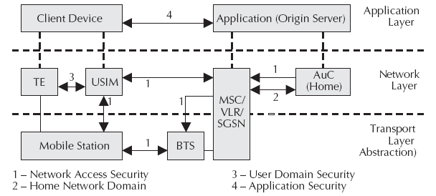
3GPP Security

Slide 73
Mobile VPN
Mobile VPN is a private network over a public network to connect two endpoints. Instead of using a dedicated physical connection such as leased line, a VPN uses virtual connections routed through the Internet from the enterprise's private network to the remote mobile device.
VPN implements this through an encrypted private connection between nodes. It generally uses IPSec and other PKI frameworks to offer confidentiality, authentication, non-repudiation (through digital signature) and integrity.
With mobile VPN, mobile workers have the freedom to safely use wireless applications on their PDAs, smart phones and other handheld devices in the field as if they are in a private network.

Slide 74
Smartcard Security
Smart cards offer data encryption and the ability to store secret information for the purpose of authenticating the cardholder.
To counter brute force attack, a smartcard processor does not allow more than 10 attempts to read a file data with wrong password.
Therefore, a user can make use of the card as a security factory.
Using this security factory is quite easy through Java card interfaces. In Java card technology, a Java interface is provided on the SIM card. Java Cryptographic Architecture (JCA) and Java programs running on the smartcard can do all these things quite easily.

Slide 75
Mutual and Spatial Authentication
Using SIM card, we can do client authentication over wireless wide area networks. This is called mutual authentication because using GSM procedures, a client can authenticate the server while server can also authenticate the client.
Location information then can be used to implement spatial authentication. For example, if the user is in a neighborhood which is insecure, access to some critical applications can be prevented.

Slide 76
Mobile Agent Security
Mobile agent technology results in significant security threats from both malicious agents and malicious hosts. For example, as the mobile agent traverses multiple hosts that are trusted to different degrees, its state may be changed in a way that an adversely can impact the decision making process of the agent.

Slide 77
Mobile Virus
As the mobile device becomes more intelligent with more flexibility and higher capabilities, viruses are surfacing.
The principles these viruses use are similar in concept as the desktop viruses do.

Slide 78
Mobile Worm
On a mobile equipment, worms can replicate and propagate through both TCP/IP and SMS interfaces of JavaPhone, Personal Java or J2ME framework and other execution environments.
Along with JavaPhone, technology on the mobile equipment, JavaCard facility is also available on the SIM cards.
Using all these technologies, it will be possible to develop viruses, worms, and trojan horses for mobile phones.
These viruses and worms will be able to replicate, access the address book, use the network facility and propagate. Therefore, security will still be needed.

Slide 79
Next Chapter
Next Generation Networks
Thanks

